Slide 1
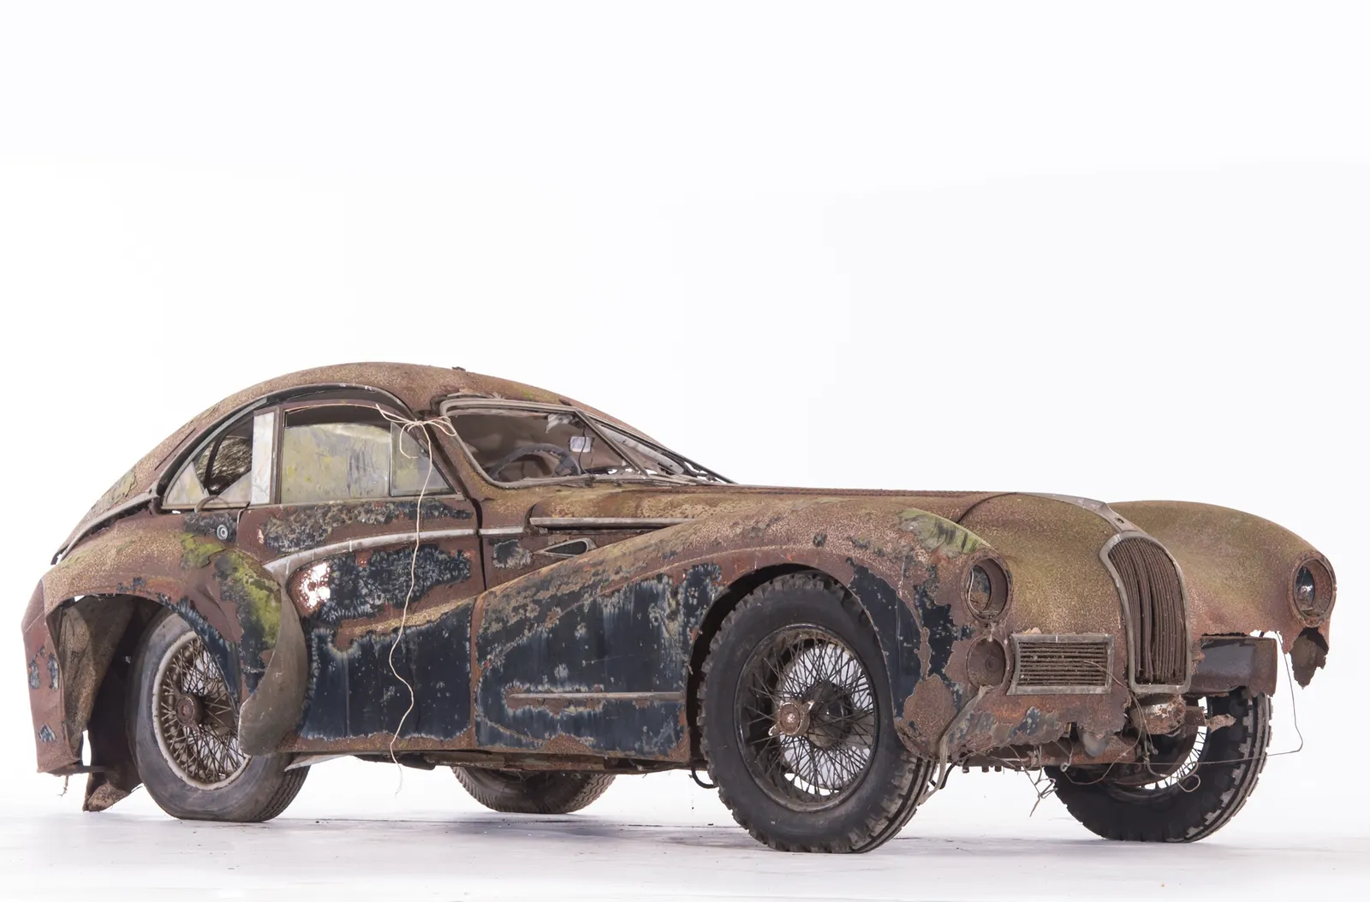
Dan’s Car Barn
Group 1
Braden Cook - Testing and Reviewing
Hyrum Cooper - Frontend Design
Max Ramsdell - Backend Developer
Stockton Smith - UI Implementation
Shawn Thorne - Product Owner

Slide 2
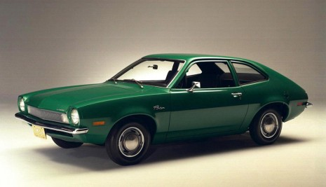
Project Overview
The main design decisions for this project included:
A browse view that allows users to see all available cars.
A reservations view that allows users to view their past, current, and upcoming reservations
A manage view that allows managers to edit users and reservations
A user view that allows editing of account information, including login credentials and the user’s account balance in dollars.

Slide 3
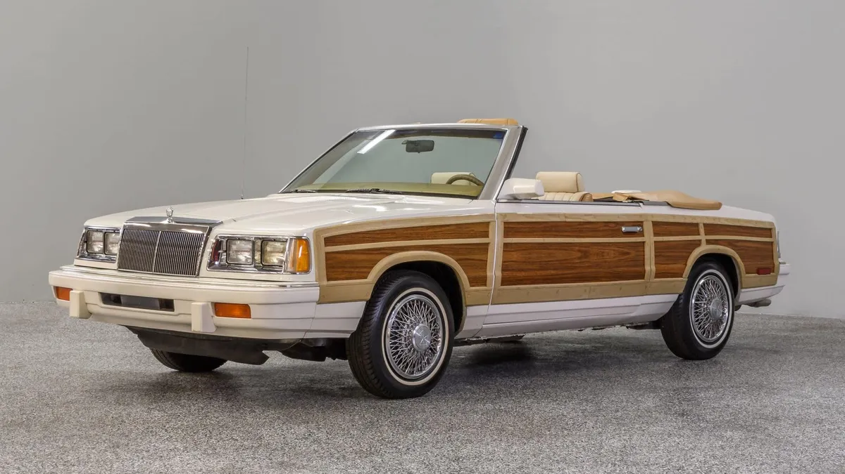
Requirement 1 - Login Page
Definition: Authenticates authorized users, allowing them to begin using the website features.

Slide 4
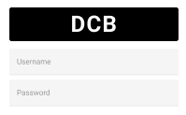
Requirement 1 - Login Page
Prototype:

Slide 5
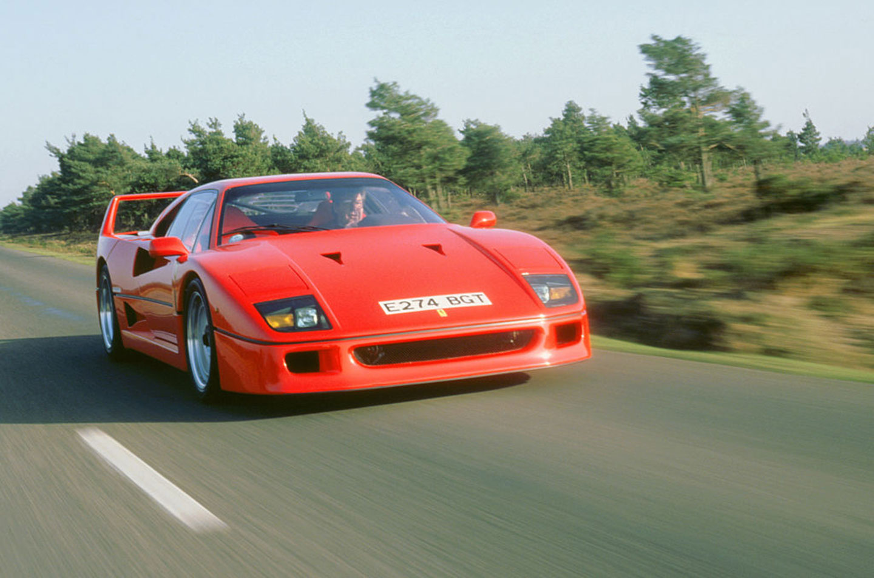
Requirement 1 - Login Page
Testing:
Unit tests for the login page functionality included adding dummy users into the database, then logging into the website using their credentials. We also verified that any user not in the database is denied access.

Slide 6

Requirement 2 - Reservation Manager
Definition: Users need the ability to specify a range of dates in which they can claim an available vehicle.
Users should not be able to reserve vehicles during time periods in which they are reserved by other users.

Slide 7
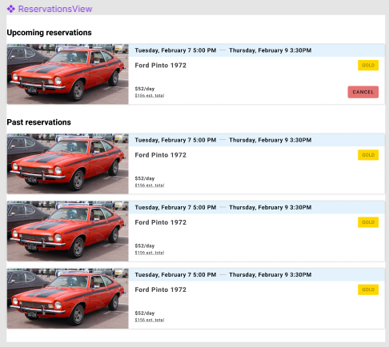
Requirement 2 - Reservation Manager
Prototype:
Users can reach the reservations view by clicking on the “Reservations” tab.

Slide 8
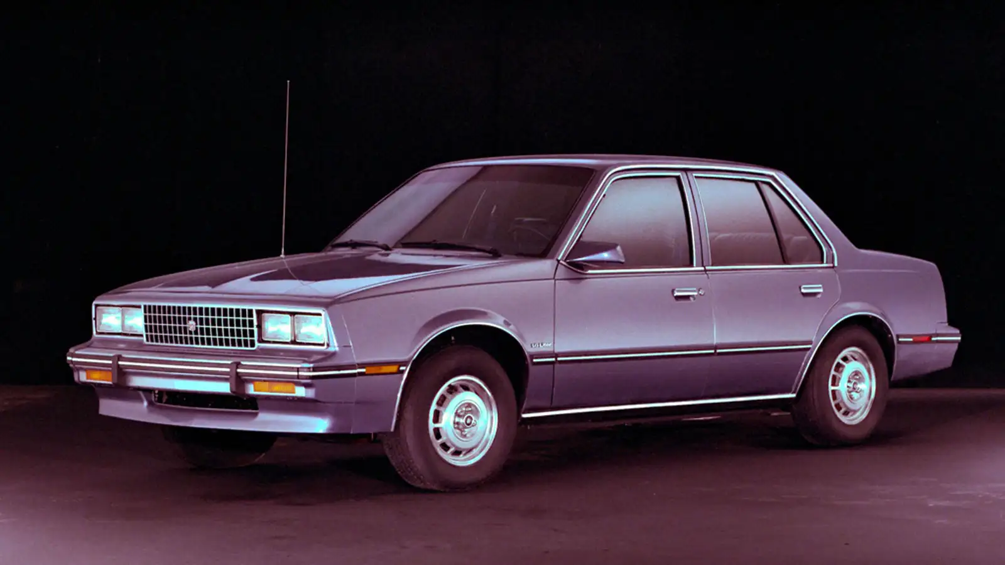
Requirement 2 - Reservation Manager
Testing:
Test cases for the reservation functionality included ensuring the following:
Users can specify a range of dates to reserve a vehicle
Only available vehicles can be reserved by users (i.e. not reserved by other users)
Reservation history can be viewed by the user in the reservations view

Slide 9

Requirement 3 - Money Manager
Definition: Users must have enough money to cover the cost of a reservation. Users can add money in their account settings, and employees and managers earn money for each reservation made/returned by a user.

Slide 10
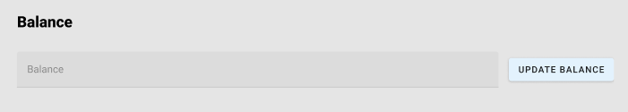
Requirement 3 - Money Manager
Prototype:
( This feature is found in the user settings in the user view )

Slide 11

Requirement 3 - Money Manager
Testing: In order to test the transaction endpoint, we successfully performed the following tasks:
Users can add money at their will and pleasure
Users cannot reserve vehicles without sufficient funds
Managers are paid each time a reservation is made; employees are paid when a reservation is returned

Slide 12

Screen Capture 1 - Manager Adding Vehicle

Slide 13
Screen Capture 2 - Customer Add Balance

Slide 14
Screen Capture 3 - Reservation Status

Slide 15
Screen Capture 4 - Add User

Slide 16
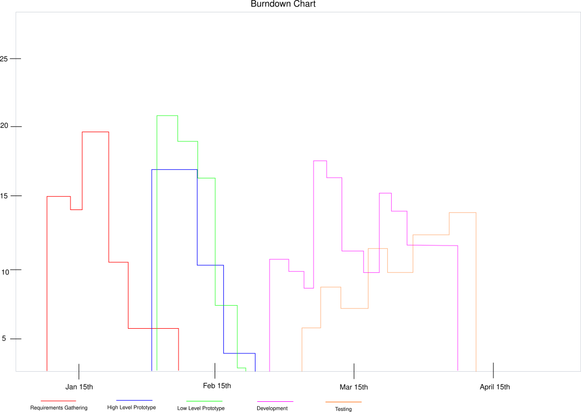
Burndown Chart
Red: Requirements Gathering
Blue: High Level Prototype
Green: Low Level Prototype
Pink: Development
Orange: Testing

Slide 17
Most Helpful Resources During The Project
Vue Documentation - - - - - - https://vuejs.org
Figma - - - - - - - - - - - - - - - - - https://www.figma.com
Mozilla HTML Reference - - - https://developer.mozilla.org/en-US/docs
Sequelize Docs - - - - - - - - - - https://sequelize.org
Postman - - - - - - - - - - - - - - https://www.postman.com

Slide 18
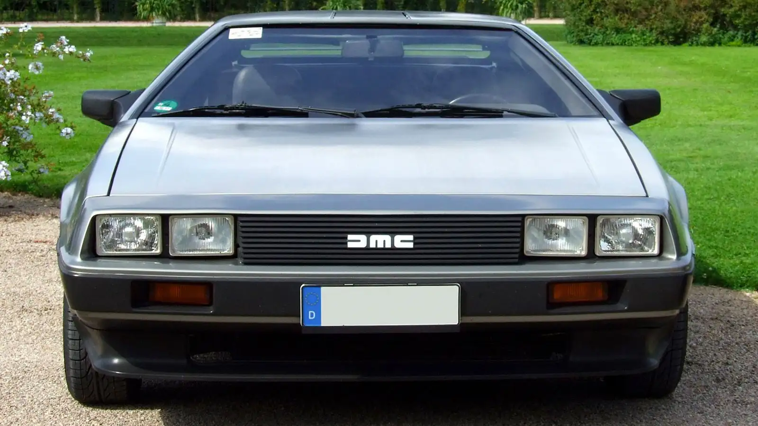
Questions?
Please don’t ask us anything

